Slide 1

School of Computing Science and Engineering
Subject Name: Data Analytics Excel Tableau Subject Code: BCS01T1001
CAT-3 Presentation
Topic Name→ Histogram
Programme Name: B.Tech. (CSE)
Section: 7
NAME:-
ROUNAK KUMAR(21SCSE1010515)
PUSHKAR AASHISH (21SCSE1010769)
SHIVAM DWIVEDI(21SCSE1010662)
CHANDNI KUMARI (21SCSE1011346)
SAURABH SAH (21SCSE1011305)
Group Number: 1
SUBMITTED TO:-
DR. BHARAT BHUSHAN SIR

Slide 2
TABLE OF CONTENT:-
TABLE OF CONTENT
Histogram
Importance of Histogram
How to make Histogram
Conclusion

Slide 3

Histogram
Histogram A histogram is a graphical representation that organizes a group of data points into user-specified ranges. Similar in appearance to a bar graph, the histogram condenses a data series into an easily interpreted visual by taking many data points and grouping them into logical ranges or bins.
Importance of a Histogram Creating a histogram provides a visual representation of data distribution. Histograms can display a large amount of data and the frequency. The function will calculate and return a frequency distribution. We can use it to get the frequency of values in a dataset.

Slide 4
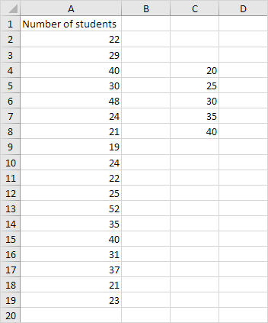
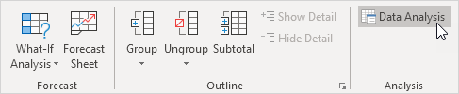
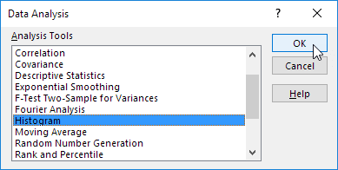
How to make a histogram
To make a Histogram Firstly you want to check data analysis tool package installed or not →
Step-1. First, enter the bin numbers (upper levels) in the range C4:C8.
Step-2. On the Data tab, in the Analysis group, click Data Analysis.
Step-3. Select Histogram and click OK.

Slide 5
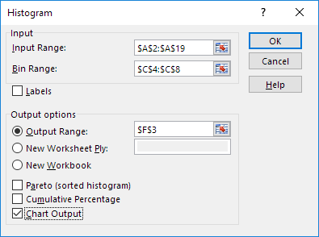
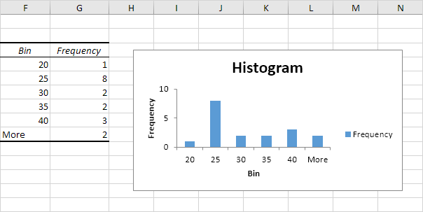
Histogram
Step-4. Select the range A2:A19.
Step-5. Click in the Bin Range box and select the range C4:C8.
Step-6. Click the Output Range option button, click in the Output Range box and select cell F3.
Step-7. Check Chart Output.
Step-8. Click OK.

Slide 6
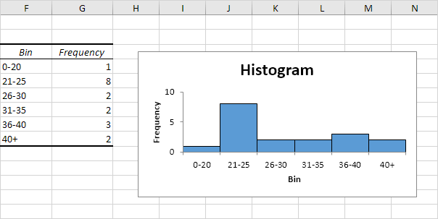
Histogram
Step-9. Click the legend on the right side and press Delete.
Step-10. Properly label your bins.
Step-11. To remove the space between the bars, right click a bar, click Format Data Series and change the Gap Width to 0%.
Step-12. To add borders, right click a bar, click Format Data Series, click the Fill & Line icon, click Border and select a color.

Slide 7
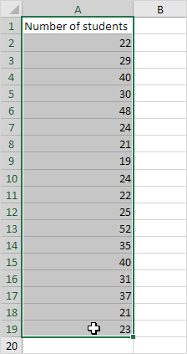
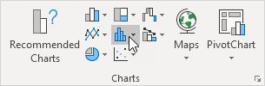
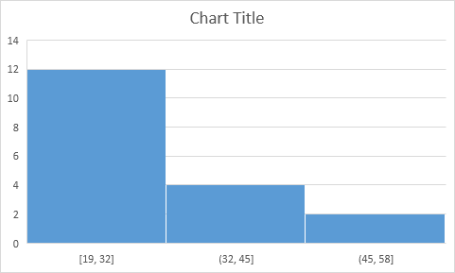
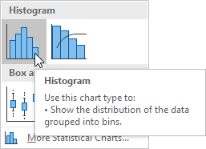
Histogram
Note:- If you have Excel 2016 or later, simply use the Histogram chart type.
Step-13. Select the range A1:A19.
Step-14. On the Insert tab, in the Charts group, click the Histogram symbol.
Step-15. Click Histogram.
Result. A histogram with 3 bins.

Slide 8
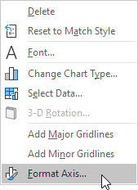
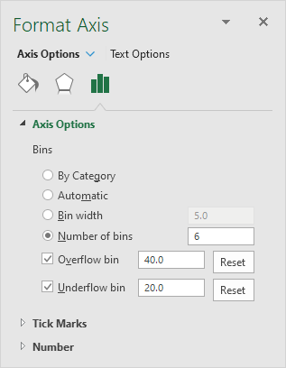
Histogram
Note: Excel uses Scott's normal reference rule for calculating the number of bins and the bin width.
Step-16. Right click the horizontal axis, and then click Format Axis.
The Format Axis pane appears.
Step-17. Define the histogram bins. We'll use the same bin numbers as before (see first picture on this page). Bin width: 5. Number of bins: 6. Overflow bin: 40. Underflow bin: 20.

Slide 9
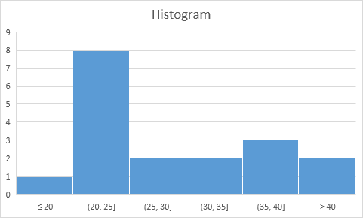
Histogram
Result:
Recall, we created the following histogram using the Analysis ToolPak (steps 1-12).
Conclusion: the bin labels look different, but the histograms are the same. ≤20 is the same as 0-20, (20, 25] is the same as 21-25, etc.

Slide 10


